Slide 1
Self adjusted auto provision system at resource level
Weekly report 20th May
You Hu

Slide 3
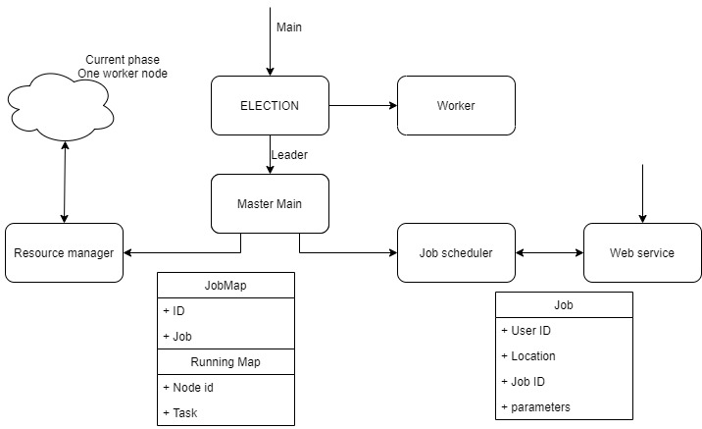
Simple Design
Same code, Different action

Slide 4
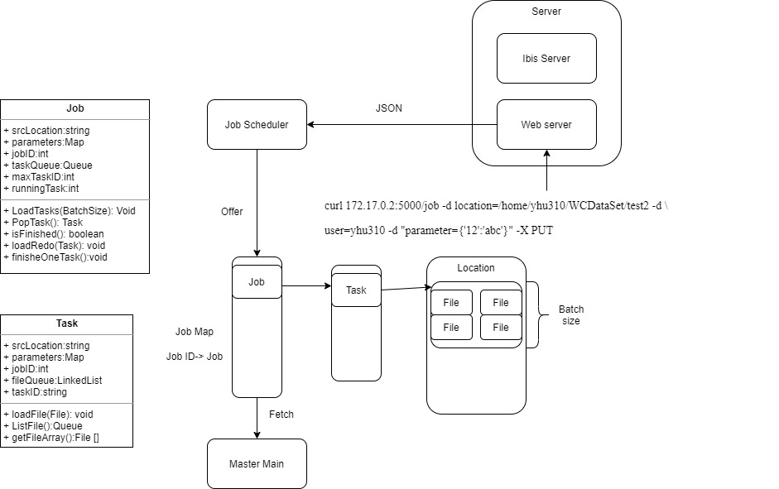
Job submission
RestFul API
Job loads files to tasks

Slide 5
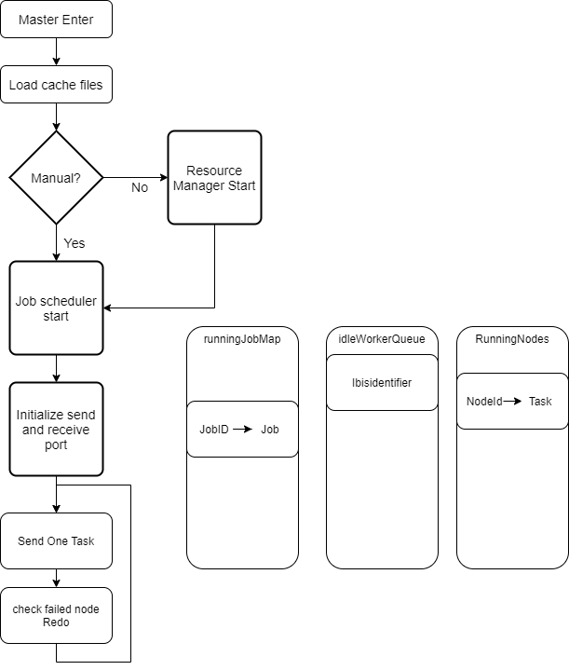
Master main
First initial settings
Then loops for task deliver and fault task redo

Slide 6
Master send one task
If idleWorkerQueue not empty && runningJobMap not empty
Fetch a Task from runningJobMap and a ibisIdentifier from idleWorkerQueue
Send
If success: Add pair <ibisIdentifier, Task> to RunningNodes
If failed(connection failed): pop a new ibisIdentifier, Send again
If idleWorkerQueue is empty: redo Task, and end this section
FIFO Job/Task Queue
Tree map: sorted via the key(Job Id)
Pop task: iterate, if taskQueue is not empty, pop a task, else next job(with ascending order by the JobId）

Slide 7
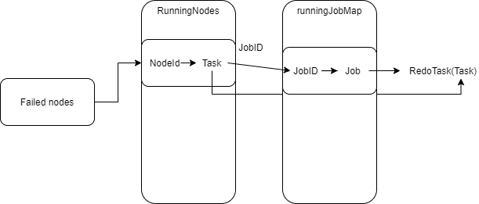
Master check failed
Fetch the dead/left nodes since last call
Find the Intersection between dead/left set and running Nodes
According to the id of failed node, redo the task
Caching the RunningJobMap and the tasks on RunningNodes

Slide 8
Master Upcall
ControlMessage m = (ControlMessage) readMessage.readObject(); readMessage.finish(); synchronized (idleWorkerQueue) { synchronized (runningNodes) { runningNodes.remove(readMessage.origin().ibisIdentifier());// No matter whether there is, it can be removed idleWorkerQueue.offer(readMessage.origin().ibisIdentifier());// add this active node to idleQueue } } if (m.isEmptyRequest() == false) { // false-> this controlMessage carrys result of task; true-> this is an init message System.out.println("Job:" + m.getJobID() + " Task:" + m.getTaskID() + " Finished with code:" + m.getStatusCode()); synchronized (runningJobMap) { runningJobMap.get(m.getJobID()).finishOneTask(); if (runningJobMap.get(m.getJobID()).isFinished()) { runningJobMap.remove(m.getJobID()); // If all task of this job finished, it can be removed from running Job Map } } }

Slide 9
Worker main
Init ports
Send a init controlMessage to master notify an active node join
Loop (finished==false)
Fetch a Task from workerTaskQueue
Process the Task with given: location, paramenters
Send back the result to master
TODO: any time detect fail of master, forcedly terminate the task and reelection

Slide 10
Worker Upcall
Task t = (Task) readMessage.readObject(); readMessage.finish(); synchronized (workerTaskQueue) { workerTaskQueue.offer(t); }

Slide 11
Fault tolerance
Worker failed
Master detects the failed nodes
Redo the task
Master failed
Pre-processing: periodically snapshots
Worker detects master failing
Reelection
New master load the snapshot
Server(TODO)
Ideally using backup site; and switch back when server is available

